Slide 1
Module 9: Firewall Technologies
Networking Security v1.0
(NETSEC)
Notes:
Networking Security (NETSEC) Module 9: Firewall Technologies

Slide 2
Module Objectives
Module Title: Firewall Technologies
Module Objective: Explain how firewalls are implemented to provide network security.
Topic Title | Topic Objective
Secure Networks with Firewalls | Explain how firewalls are used to help secure networks.
Firewalls in Network Design | Explain design considerations for implementing firewall technologies.
Notes:
2
1 – Networking Today
1.0.2 – What will I learn to do in this module?

Slide 3
9.1 Secure Networks with Firewalls
Notes:
9: Firewall Technologies 9.1: Secure Networks with Firewalls

Slide 4
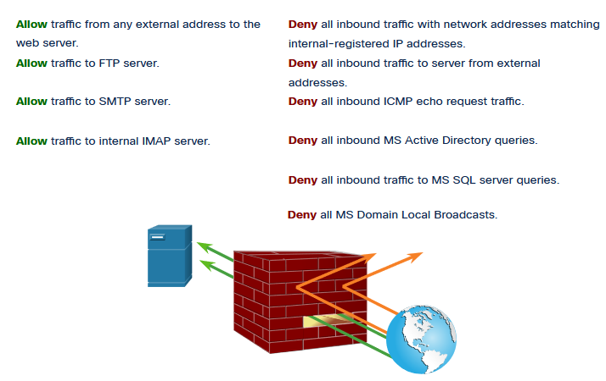
Secure Networks with Firewalls
Firewalls
All firewalls share some common properties:
Firewalls are resistant to network attacks.
Firewalls are the only transit point between internal corporate networks and external networks because all traffic flows through the firewall.
Firewalls enforce the access control policy.
Different types of firewalls have different benefits and limitations.
Notes:
9: Firewall Technologies 9.1: Secure Networks with Firewalls 9.1.1: Firewalls

Slide 5
Secure Networks with Firewalls
Types of Firewalls
It is important to understand the different types of firewalls and their specific capabilities so that the right firewall is used for each situation.
Packet Filtering (Stateless) firewalls - These are usually part of a router firewall, which permits or denies traffic based on Layer 3 and Layer 4 information. They are stateless firewalls that use a simple policy table look-up that filters traffic based on specific criteria.
Stateful firewalls – These are the most versatile and the most common firewall technologies in use. Stateful firewalls provide stateful packet filtering by using connection information maintained in a state table. Stateful filtering is a firewall architecture at the network layer.
Application Gateway (Proxy) firewalls – These filter information at Layers 3, 4, 5, and 7. Most of the firewall control and filtering is done in software. When a client needs to access a remote server, it connects to a proxy server.
Next Generation firewalls – These go beyond stateful firewalls by providing integrated intrusion prevention, application awareness and control, upgrade paths to include future information feeds, and techniques to address evolving security threats.
Notes:
9: Firewall Technologies 9.1: Secure Networks with Firewalls 9.1.2: Types of Firewalls
9.1.3: Check Your Understanding – Identify the Type of Firewall

Slide 6
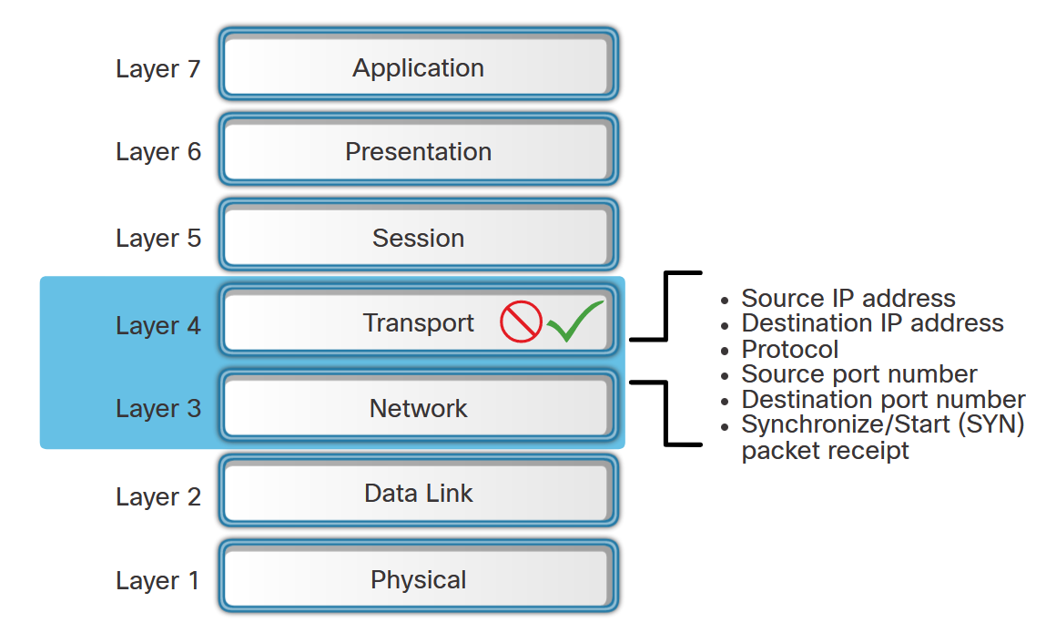
Secure Networks with Firewalls
Packet Filtering Firewall Benefits and Limitations
Benefits of Packet Filtering Firewalls:
They implement simple permit or deny rule sets.
They have a low impact on network performance.
They are easy to implement and are supported by most routers.
They provide an initial degree of security at the network layer.
They perform many of the tasks of a high-end firewall at a much lower cost.
Limitations of Packet Filtering Firewalls:
They are susceptible to IP spoofing.
They do not reliably filter fragmented packets.
They use complex ACLs, which can be difficult to implement and maintain.
They cannot dynamically filter certain services.
They are stateless.
Notes:
9: Firewall Technologies 9.1: Secure Networks with Firewalls 9.1.4: Packet Filtering Firewall Benefits and Limitations

Slide 7
Secure Networks with Firewalls
Stateful Firewall Benefits and Limitations
The table lists benefits and limitations of stateful firewalls.
Benefits | Limitations
Primary means of defense | No Application Layer inspection
Strong packet filtering | Limited tracking of stateless protocols
Improved performance over packet filters | Difficult to defend against dynamic port negotiation
Defends against spoofing and DoS attacks | No authentication support
Richer data log
Notes:
9: Firewall Technologies 9.1: Secure Networks with Firewalls 9.1.5: Stateful Firewall Benefits and Limitations

Slide 8
9.2 Firewalls in Network Design
Notes:
9: Firewall Technologies 9.2: Firewalls in Network Design

Slide 9
Firewalls in Network Design
Common Security Architectures
Firewall design is primarily about device interfaces permitting or denying traffic based on the source, the destination, and the type of traffic. Here are three common firewall designs:
Private and Public
Demilitarized Zone (DMZ)
Zone-Based Policy
Notes:
9: Firewall Technologies 9.2: Firewalls in Network Design 9.2.1: Common Security Architectures

Slide 10
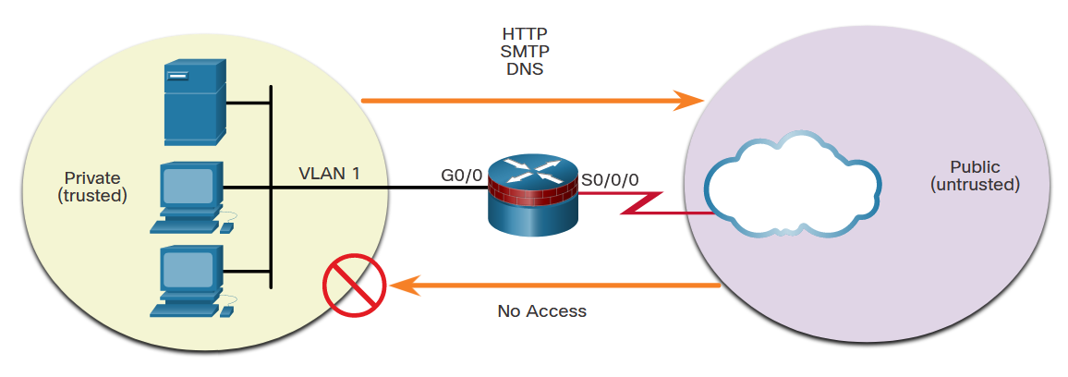
Firewalls in Network Design
Common Security Architectures (Cont.)
Private and Public - The public network (or outside network) is untrusted, and the private network (or inside network) is trusted.
Notes:
9: Firewall Technologies 9.2: Firewalls in Network Design 9.2.1: Common Security Architectures

Slide 11
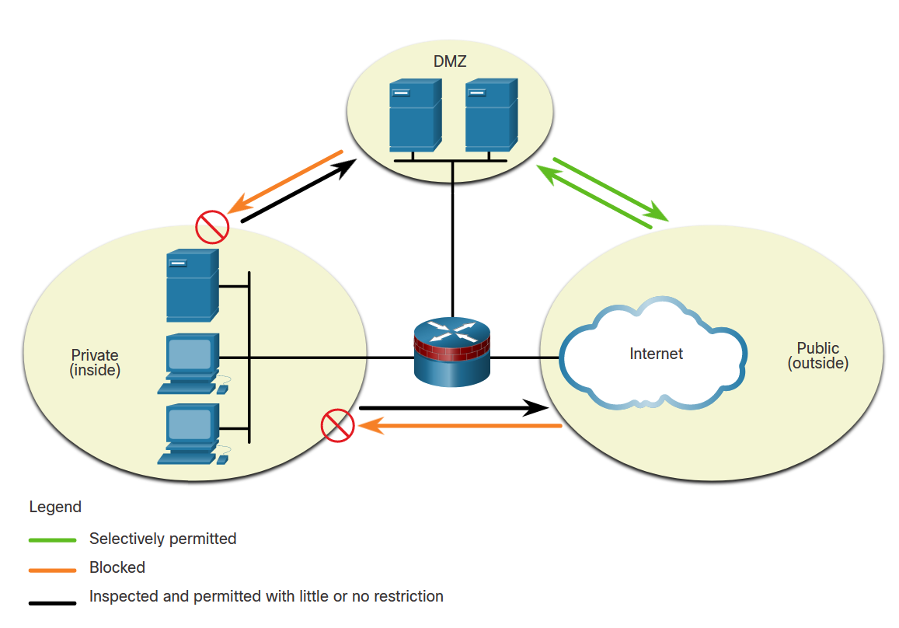
Firewalls in Network Design
Common Security Architectures (Cont.)
Demilitarized Zone (DMZ) - This is a firewall design where there is typically one inside interface connected to the private network, one outside interface connected to the public network, and one DMZ interface.
Notes:
9: Firewall Technologies 9.2: Firewalls in Network Design 9.2.1: Common Security Architectures

Slide 12
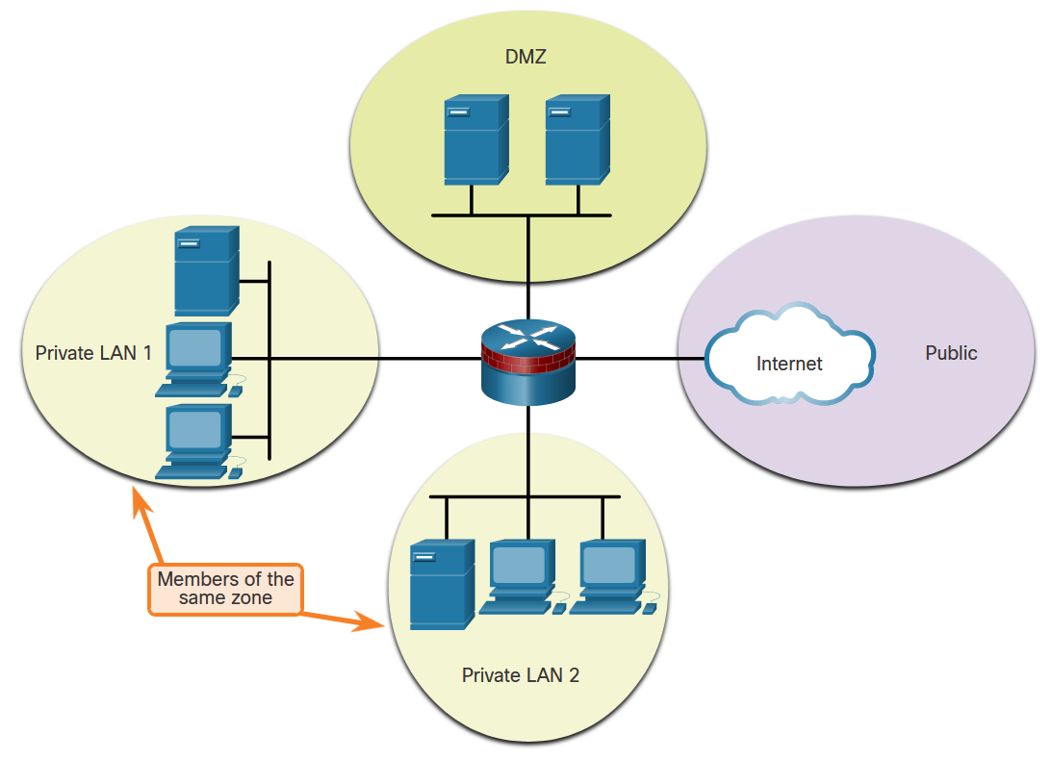
Firewalls in Network Design
Common Security Architectures
Zone-Based Policy - Zone-based policy firewalls (ZPFs) use the concept of zones to provide additional flexibility. A zone is a group of one or more interfaces that have similar functions or features. Zones help you specify where a Cisco IOS firewall rule or policy should be applied.
Notes:
9: Firewall Technologies 9.2: Firewalls in Network Design 9.2.1: Common Security Architectures

Slide 13
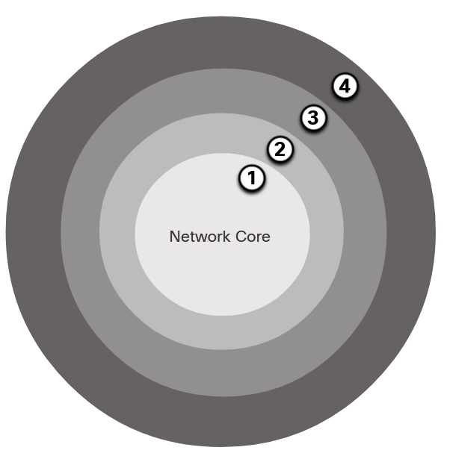
Firewalls in Network Design
Layered Defense
A layered defense uses different types of firewalls that are combined in layers to add depth to the security of an organization. Policies can be enforced between the layers and inside the layers. The following example shows four layers of security.
Network Core security - Protects against malicious software and traffic anomalies, enforces network policies, and ensures survivability
Perimeter security - Secures boundaries between zones
Communications security - Provides information assurance
Endpoint security - Provides identity and device security policy compliance
Notes:
9: Firewall Technologies 9.2: Firewalls in Network Design 9.2.2: Layered Defense
9.2.3: Check Your Understanding – Identify Basic Security Architecture for Firewalls

Slide 14
Firewalls in Network Design
Layered Defense (Cont.)
This partial list of best practices can serve as a starting point for a firewall security policy.
Position firewalls at security boundaries. Firewalls are a critical part of network security, but it is unwise to rely exclusively on a firewall for security.
Deny all traffic by default.
Permit only services that are needed.
Ensure that physical access to the firewall is controlled.
Regularly monitor firewall logs.
Practice change management for firewall configuration changes.
Remember that firewalls primarily protect from technical attacks originating from the outside.
Notes:
9: Firewall Technologies 9.2: Firewalls in Network Design 9.2.2: Layered Defense
9.2.3: Check Your Understanding – Identify Basic Security Architecture for Firewalls

Slide 15
Firewalls in Network Design
Packet Tracer - Identify Packet Flow
In this Packet Tracer activity, you will observe packet flow in a LAN and WAN topology. You will also observe how the packet flow path may change when there is a change in the network topology.
Notes:
9: Firewall Technologies 9.2: Firewalls in Network Design 9.2.4: Packet Tracer - Identify Packet Flow

